Slide 1
VELAMMAL ENGINEERING COLLEGE
(An Autonomous Institution)
Ambattur Red Hills Rd, Velammal Nagar, Surapet, Chennai, TamilNadu 600066

Slide 2
AI BASED DISCOURSE FOR
BANKING INDUSTRY
TEAM ID: PNT2022TMID23608 ​
BHUVANESHWARI M (113219071004)​
MIRIDINI V (113219071019)​
SAHANA JM (113219071033)​
SUJI N (113219071043)​
Industry mentor :Mrs.Durga Prasad
Faculty mentor:Mrs.S.Vinodhini
Evaluator name:Mrs.CM.Nalayini

Slide 3
ABSTRACT
In this project, we will be building a Chat Bot using IBM Watson’s assistant. This Chat Bot will have the ability to perform activities such as guiding the customer to create a bank account, answering loan queries, general bank queries, queries related to net banking and all such kind of similar needs. With the help of this bot the customer will be able to get all the required details related to banking. This bot is deployed using Python-Flask. We will be building a Flask application which will be running in our local browser with a user interface. We will also make use of Python, NLP, IBM Cloud, Deep learning to build this Chat Bot. In the flask application the users will be able to interact with Bot and clear their queries.​

Slide 4
PROBLEM STATEMENT
ProblemStatement(PS) | Iam(Customer) | I’mtrying to | But | Because | Whichmakes mefeel
PS-1 | A bankCustomer | Do mytransactionsviabank | Ittakeslongtime | Thebank isrushanddistant | frustrated
PS-2 | ATraveller | To send mymoney to myfamily | It isinconvenient | I don’t stayin a singleplace for along timeandIkeeptravelling | I couldn’t support myfamily
PS-3 | Priya, abusyworkingwoman | To do mytransactionsviabank | It is notpossible | I don’t haveenoughtimetogobankdirectly | unfinished
PS-4 | Hosteller | Avail aneducationalloan | I amunawareofthedetails | My hostelhas strictoutingrestrictionssoIcouldn’tgobankdirectly | Thatmyfeepaymentis pending

Slide 5
PROPOSED SOLUTION
To solve this Problem, we are going to design an AI Chatbot using IBM Watson Assistant which saves the Customer’s time and cost as they don't need to go bank directly. We are going to Deploy using Python Flask. We are also going to make use of many trending features such as NLP, NLU and IBM Cloud. We are going to train our model using Deep Learning. Our Chatbot will be built in such a way that it can Chat for hours without the need for human supervision.

Slide 6
WORK FLOW
Create IBM Services.
Creating skills & Assistant for Chatbot.
Creating Savings account action.
Creating Current account action.
Creating Loan account action.
Creating a general query action.
Creating a Net banking action.
Create HTML web page.
Integrate the Watson Chatbot with web page.

Slide 7
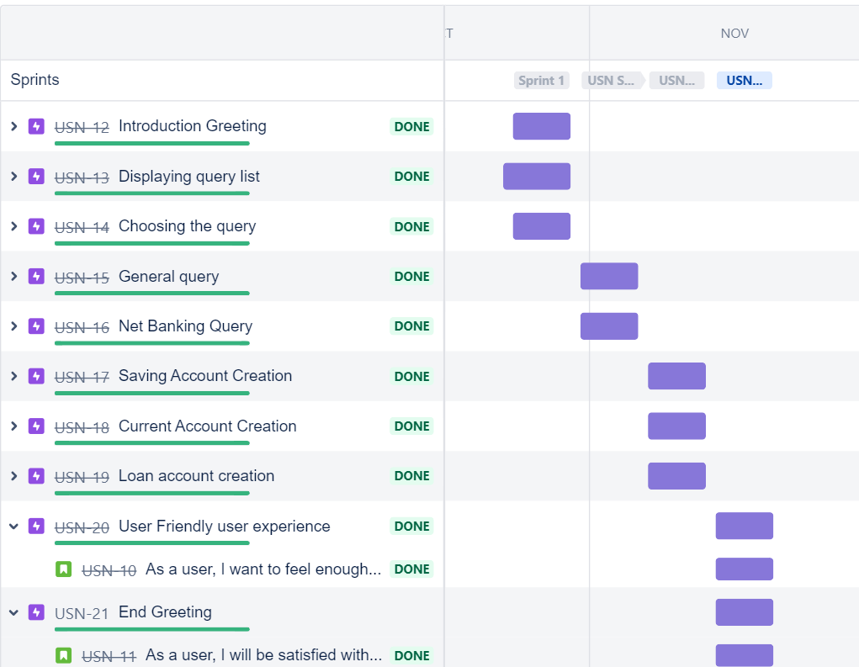
JIRA

Slide 8
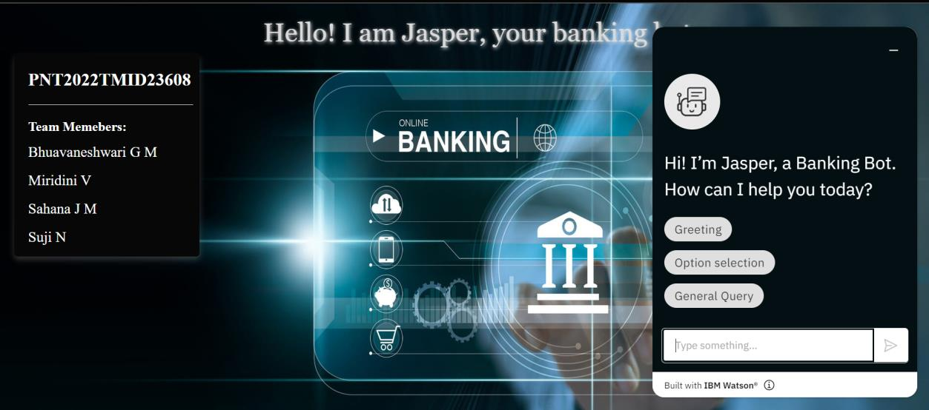
OUTPUT

Slide 9
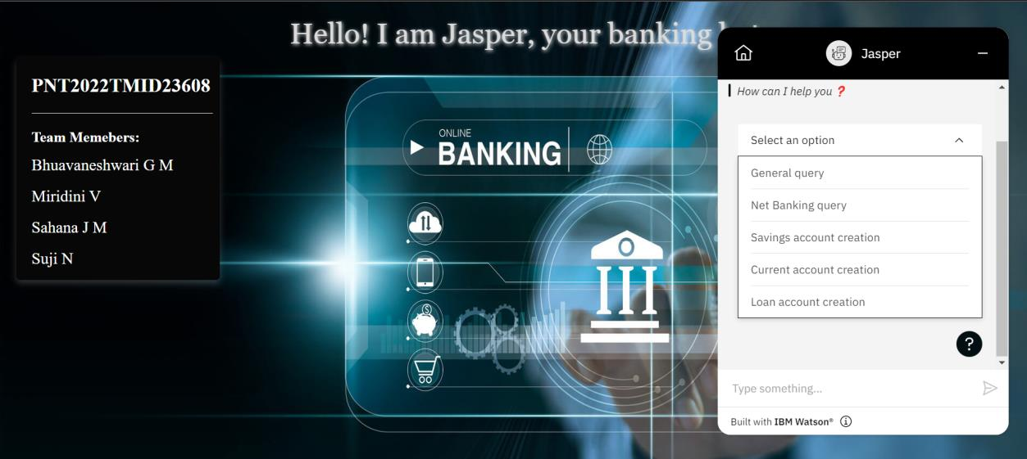

Slide 10
FUTURE ENHANCEMENT
We can enhance this project further by adding these features
Bot can do audio message greeting
Bot can greet the user in the language in which the users are comfortable(Multilanguage support)
Do sentiment analysis in customer message. With sentiment analysis, bots can figure out your happy and annoyed users.
We can add call services in Chatbot
Bots can greatly reduce the number of human agents required and also improve the employee attrition ratio which is due to the repetitive nature of routine calls.

Slide 11
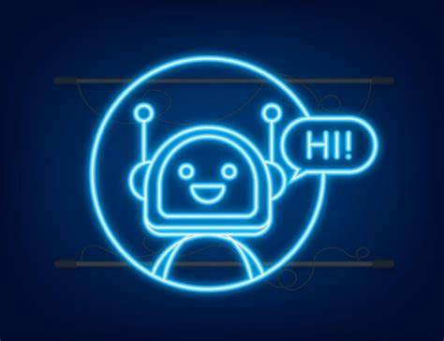
THANK YOU!

